Slide 1
JBOSS Administration
Dekrinssoft Technologies-Krishna

Slide 2
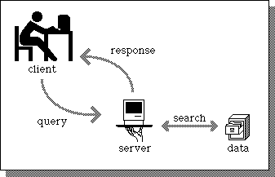
Introduction to Servers
1. What is an application
2. Why we need an application
3. What is a Server
4. What are the App Servers in IT Industry
5. What is the job role of JBOSS Administrator

Slide 3
JBOSS History
Marc Fleury started the JBoss project in 1999.
RedHat Acquired JBOSS in Jun 2006 for $420 million
http://jbossas.jboss.org/downloads

Slide 4
Features of JBOSS
1. Fast
2. High availability and clustering
3. Modular Architecture
4. New Management tools
5. Centralized administration / domain mode
6. Simplified configuration Files
7. Light weight – less memory
8. Cloud

Slide 5
Wildfly and EAP
Wildfly latest version
http://wildfly.org/downloads/
15.0.0 Final 30-Nov-2018
EAP
https://developers.redhat.com/products/eap/download/
7.2.0 22-JAN-2019

Slide 6
JBOSS Installation Prerequisites
Install JAVA
Configure Path
256 mb ram
500 mb free space

Slide 7
Java & JBOSS Version
EAP 6.x supports Oracle JDK 1.6 and 1.7
EAP 6.3.3 and above supports JDK 1.6, JDK 1.7 an JDK 1.8
Install Java and configure JAVA Path
In Windows
JAVA_HOME=C:\Program Files\Java\jdk1.8.0_144
Path=C:\Program Files\Java\jdk1.8.0_144\bin
In Linux
export JAVA_HOME=/installDir/jdk1.6.0_26
export PATH=$JAVA_HOME/bin:$PATH

Slide 8
JBOSS Installation Types
We can install JBOSS in 5 ways
1. Zip Extraction
2. GUI Mode (by using installer jar)
3. Console Mode
4. Automatic Installation
5. By Using RPM (yum groupinstall jboss-eap6)

Slide 9
Installation by using Zip Extraction
Copy the downloaded zip bundle and copy to any directory (opt) and extract it
Create a user and assign the password with add-user.sh in <EAP-HOME>/bin>
Then start the server and check it’s properly extracted and working or not.

Slide 10
Installation by using GUI Mode
Execute jboss-eap-6.4.0-installer jar file
By default it will install /root/EAP-6.4.0

Slide 11
Installation by using console mode
Execute jboss-eap-6.4.0-installer jar file as below
Java -jar jboss-eap-6.4.0-installer.jar –console
Provide the values as per your requirement
If it is successfully installed we will get the below message “Console installation done”

Slide 12
Installation by using autoinstall xml or Silent mode
java -jar jboss-eap-6.4.0-installer.jar /root/Desktop/softwares/jboss/auto-tes123.xml
By default it will install /root/EAP-6.4.0

Slide 13
Installation by using rpm file
By using RPM File
rpm –ivh <file-name>.rpm

Slide 14
Uninstallation by using Console Mode
1. Go to <EAP-HOME>/uninstaller>
2. Execue java –jar uninstaller.jar -console

Slide 15
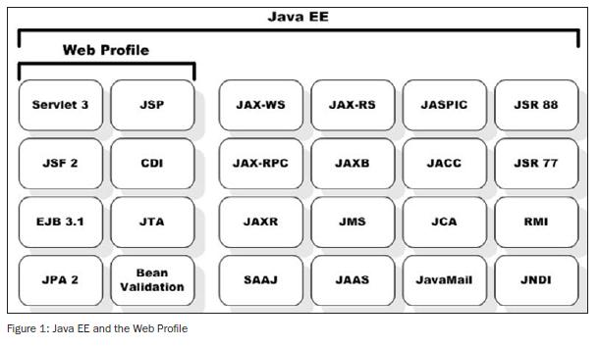
JEE Profile Components

Slide 16
JBOSS Profiles
Types of JBOSS Profiles
There are five types of profiles in JBOSS
1. default
2. full
3. ha
4. full-ha
5. load-balancer profile
A profile is a set of subsystems
default - Support of Java EE Web-Profile plus some extensions like RESTFul Web Services and EJB3 remote invocations
full - Support of Java EE Full-Profile and all server capabilities without clustering
ha - default profile with clustering capabilities
full-ha - full profile with clustering capabilities
Load-balancer – It’s a webserver with minimum capabilities, instead of using apache as a front-end server we can use load-balcer profile to route the traffic to the backend servers

Slide 17
General Concepts
Extensions : An extension is a module that extends the core capabilities of the server. An extension is packaged as a module in the modules folder. The user indicates that they want a particular extension to be available by including an <extension/> element naming its module in the domain.xml or standalone.xml file.
Profile and Subsystems: The most significant part of the configuration in domain.xml and standalone.xml is the configuration of one (in standalone.xml) or more (in domain.xml) "profiles".
A profile is a named set of subsystem configurations.
A subsystem is a place where you configure the extensions. The subsystem allows you to configure extension based on your requirement
A profile is a named list of subsystems, along with the details of each subsystem's configuration. A profile with a large number of subsystems results in a server with a large set of capabilities.
The content of an individual profile configuration looks largely the same in domain.xml and standalone.xml. The only difference is standalone.xml is only allowed to have a single profile element (the profile the server will run), while domain.xml can have many profiles, each of which can be mapped to one or more groups of servers.
The contents of individual subsystem configurations look exactly the same between domain.xml and standalone.xml.

Slide 18
Interfaces: A logical name for a network interface/IP address/host name to which sockets can be bound. The domain.xml, host.xml and standalone.xml configurations all include a section where interfaces can be declared. Other sections of the configuration can then reference those interfaces by their logical name, rather than having to include the full details of the interface (which may vary on different machines). An interface configuration includes the logical name of the interface as well as information specifying the criteria to use for resolving the actual physical address to use.
Socket Bindings and Socket Binding Groups : A socket binding is a named configuration for a socket.The domain.xml and standalone.xml configurations both include a section where named socket configurations can be declared. Other sections of the configuration can then reference those sockets by their logical name, rather than having to include the full details of the socket configuration (which may vary on different machines).

Slide 19
Starting Server with PortOffset
C:\EAP-7.0.0_Silent\bin>standalone.bat -Djboss.socket.binding.port-offset=100
C:\EAP-7.0.0_Aug\bin>standalone.bat -Djboss.server.base.dir=C:\EAP-7.0.0_Aug\standalone-node01 Djboss.socket.binding.port-offset=100

